Slide 1

Developing Interoperable Systems to Achieve Bed Management Capabilities for Emergency Department Admissions
http://www.trbimg.com/img-51367f46/turbine/la-167707-me-0909-trauma-10-rcg-jpg-20130304/600/600x399
Leslie DeYoung, David Gelman, Kevin Parker, Paul Rosenau
September 8, 2015
Notes:
The project we undertook was to begin the process of creating an IHE profile to manage the interoperability issues that surround the bed management tasks that are involved with admissions to hospitals from the emergency department. Our team involves Leslie, Kevin, Paul, and me. The project stemmed from my rather futile efforts trying push development of various health IT systems that track patient flow and movement within the VA towards interoperability. The lack of a model to follow as well as budgetary constraints and prioritization issues have been the main limitations to achieving this goal.

Slide 2
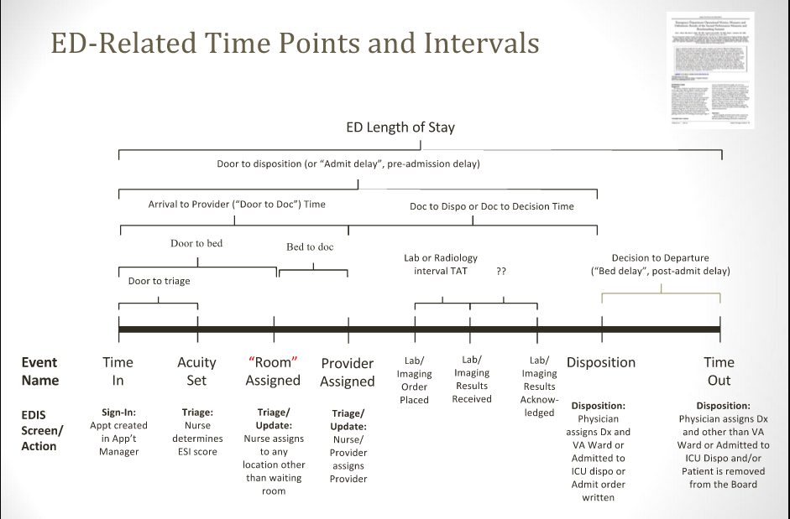
ED-Related Time Points and Intervals
Notes:
In any hospital system today, one of the main talking points is “patient-centered care”. Healthcare is, in essence, a patient on a journey and we need to understand that journey. Measuring flow and movement of patients through their care journey often involves carving up larger segments (like a emergency department stay) into smaller chunks.

Slide 3

Problem Statement
Four systems displaying lack of interoperability
EHR
ADT
BMS
EDIS
Problems exhibited from lack of interoperability
Work inefficiency ↓ for ED providers and other staff with no mechanism to monitor patient status in real time
Delays in patient transfers to inpatient units
Poor data quality to measure the performance of patient transfer and care coordination (siloed data)
http://www.boattest.com/images-gallery/News/lead_1.jpg
Notes:
Rather than focusing on the VA specifically, we abstracted the functions of the actual IT systems involved into actors. These actors include the ADT system, the EHR (where care is ordered and documented), BMS (the bed management system, which the bed czar uses to visualize bed status and capacity and plan for incoming admissions, and the EDIS which we viewed as a system which tracks the movement and status of patients in the ED. We left the caregiving aspect in the ED to a branch of the EHR, even if the given IT system in many emergency departments integrates flow management with orders and notes.
Especially in hospital systems with departmental systems (as opposed to those with products with all-in-one EHR system vendors) these various actors are spread out amongst separate health IT packages. This leads to lack of interoperability, and the consequences of this are that clinical areas are unaware of the work of other caregivers. The ED doesn’t know if there is a clean bed of the type needed for a patient, the bed czar doesn’t know how busy the ED is and how many admissions (and likely future admissions) are pending. The floors teams are unaware of the ED status or the bed czar’s planning.
One of the greatest problems is that because data is siloed, there is no way to do process improvement. Investigation into causes of delay for patient admissions end up in finger-pointing exercises between the various departments, each blaming external factors for the delays. With siloed data, it becomes exceedingly difficult to create reports that could both identify the root causes of problems and demonstrate clear improvement if changes were made.

Slide 4
Value Statement
Interoperability and data exchange among the EHR, ADT, BMS, and EDIS systems enable integrated bed management functionality
Benefits:
Increased efficiency
Reduced delays and waste
Improved patient transfer and care coordination data, resulting in better predictive planning
Notes:
Bed management is the ability for a healthcare facility or system to have real-time operational awareness of the status of all of its available beds and to be able to plan for the expedient use of this scarce resource through coordination of the bed turnover process.
In the context of the goal of our proposed profile (developing interoperable systems to achieve bed management functionality for ED admissions), enabling data exchange between previously-siloed EHR, ADT, BMS and EDIS systems provides users of each of these systems with an accurate view of where a patient is on his or her journey of care. As a result, users of these systems can perform whatever roles they play in the patient care journey with greater efficiency. For example, ward staff, the bed czar, and the bed cleaning staff can be alerted about a pending inpatient admission and can plan accordingly. Coordination of the bed turnover process among the different systems reduces the delays and waste that occur when systems can’t exchange data and real-time awareness of patient and bed status is not shared among systems. Not only does this increased efficiency and reduction in delay and waste improve the quality of patient care – it also improves the quality of the data that can be gathered about patient flow and movement. This data, in turn, can be used to replace departmental finger-pointing with the ability to objectively identify stages of the care journey that can be improved

Slide 5
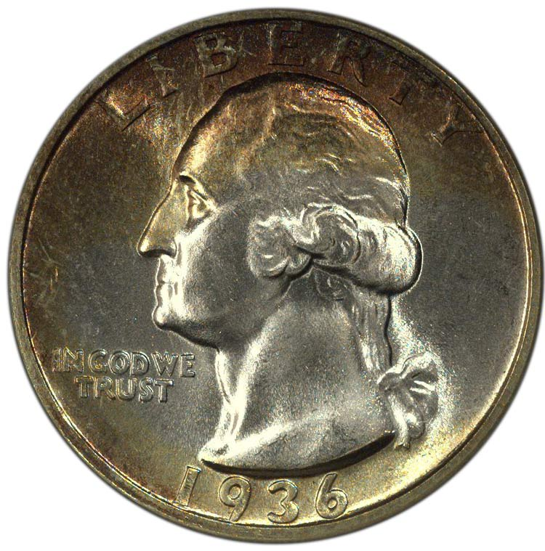
Clinical and Financial Impact
Robust, integrated bed management not only improves patient care but also impacts a hospital’s bottom line.
Prolonged post-admission delays are associated with increased mortality and length of hospital stay, even controlling for acuity and comorbid conditions.²
One hour decrease in average ED boarding time = $10,000/day increase in revenue at one inner-city teaching hospital.¹
Notes:
Reducing post-admission delays with robust, integrated bed management (achieved through interoperability and the use of standards) affects patient care by decreasing mortality and length of hospital stay.
In addition, decreasing the amount of time that a patient is boarded in the ED prior to inpatient admission affects a hospital’s bottom line (per a 2011 study conducted at an academic ED with an annual ED census of 90,000 visits).

Slide 6
Use Case
Story Board 1
Mrs. Penny arrives for care in the emergency department (ED) where an administrative clerk creates an outpatient visit (registers) Mrs. Penny in the ADT system for the ED, which is part of the EHR system. This populates EDIS with Mrs. Penny’s name and visit information. Mrs. Penny is seen by Nurse Nickel, the triage nurse. Mrs. Penny receives care in the ED from Dr. Dent, who records himself as the provider of record in EDIS. During early care of Mrs. Penny, a nurse or doctor identifies that Mrs. Penny’s complaint is likely to result in an inpatient admission. Dr. Dent and Nurse Nickel can create a “heads up” notification in EDIS to communicate the potential of an admission for Mrs. Penny to BMS. This is not a formal admission order because the patient may not be fully stabilized for admission and the clinician may not know at this time all the information necessary for an admission order (for example: service, team, level of care, and isolation or cohabitation needs). The action of creating a “heads up” notification updates a list of patients in BMS to give operational awareness of an estimate of total pending admissions from the ED.
Care proceeds, and eventually Dr. Dent decides to admit Mrs. Penny to the hospital. At this time, he enters the details of the admission into EDIS, including the necessary information regarding her bed requirements (for example: service, team, level of care, and isolation or cohabitation needs). Cohabitation and/or Isolation needs are determined using clinical decision support accomplished via patient information retrieved from Mrs. Penny’s EHR; for instance, recommending isolation if data in the EHR reveals that the patient is colonized with Methicillin-resistant Staph aureus (MRSA). Dr. Dent’s admission entry in EDIS updates Mrs. Penny’s status to display in EDIS as “admitted, waiting bed assignment.” It also creates a formal admission order in the EHR as well as a pending bed request in BMS. (Mrs. Penny is removed from the “heads up” list of patients if placed there earlier.) The information in the admission order/pending bed request identifies Mrs. Penny’s ED care team as Dr. Dent and Nurse Nickel, and this information is updated in real time in EDIS with ED staff changes .
The task of identifying an appropriate bed for Mrs. Penny involves coordination with individual wards and bed cleaning staff to locate available (or soon-to-be available) beds. Inpatient discharges and bed cleaning activities change bed statuses within BMS. The bed management administrator uses this information to identify the likely future bed for Mrs. Penny and enters the potential bed assignment into BMS. The potential bed assignment is sent from BMS to EDIS, where it is visible to ED staff. After report of Mrs. Penny’s ED course of care is communicated between ED and floor nurses, ED administrative staff update Mrs. Penny’s location in the ADT system from the ED to the ward. When Mrs. Penny leaves the ED, the ED administrator records her departure from the ED in EDIS. When Mrs. Penny arrives on the ward, the ward clerk enters in BMS that she has arrived on the ward for care.

Slide 7
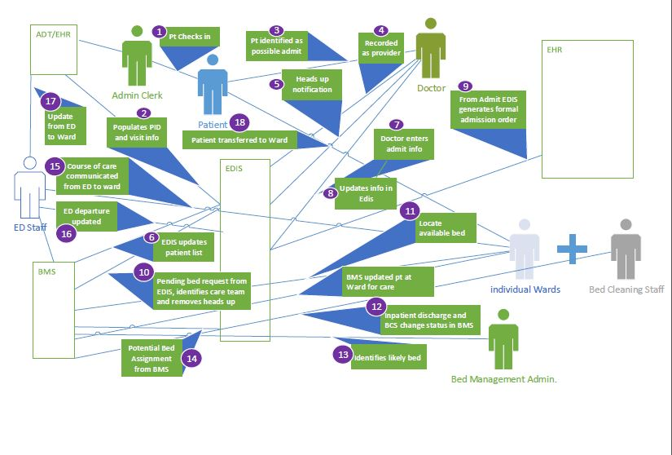
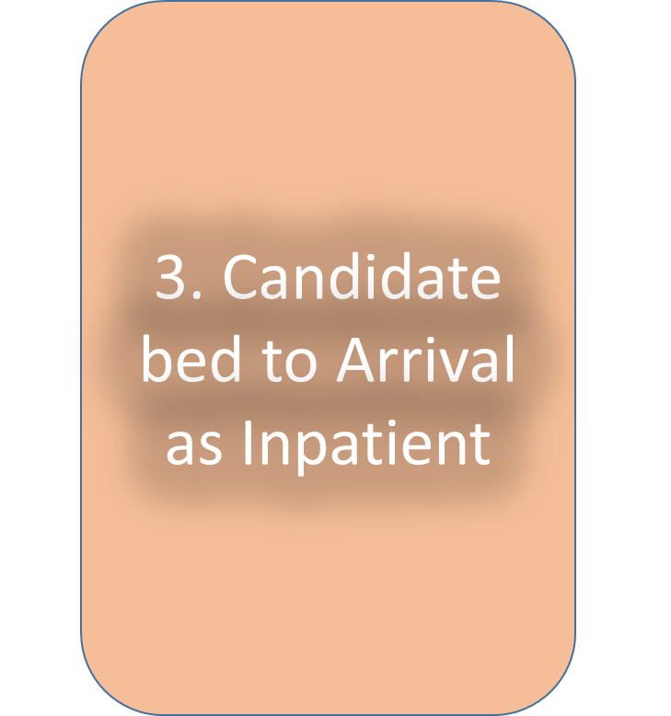
1. Arrival to Admission
2. Admission to Candidate Bed

Slide 8
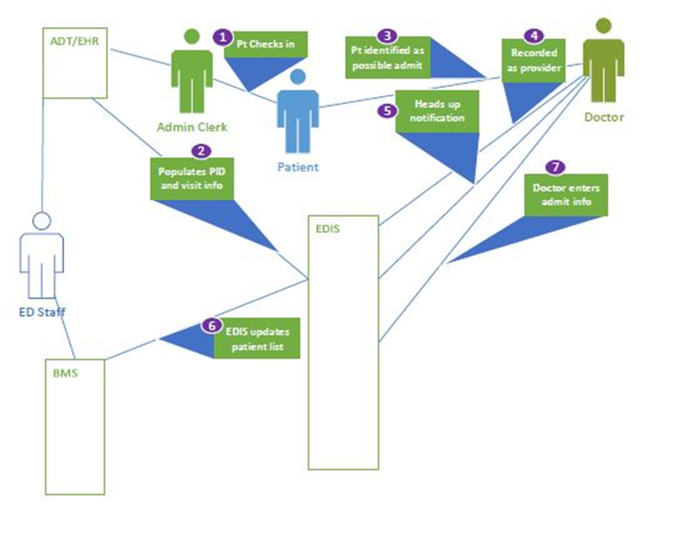
Arrival to Admission
Story Board 1

Slide 9
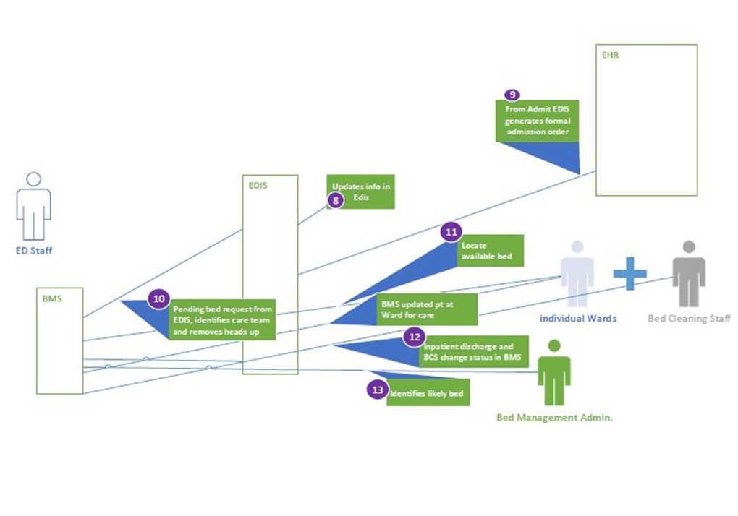
Admission to Candidate Bed
Story Board 1

Slide 10
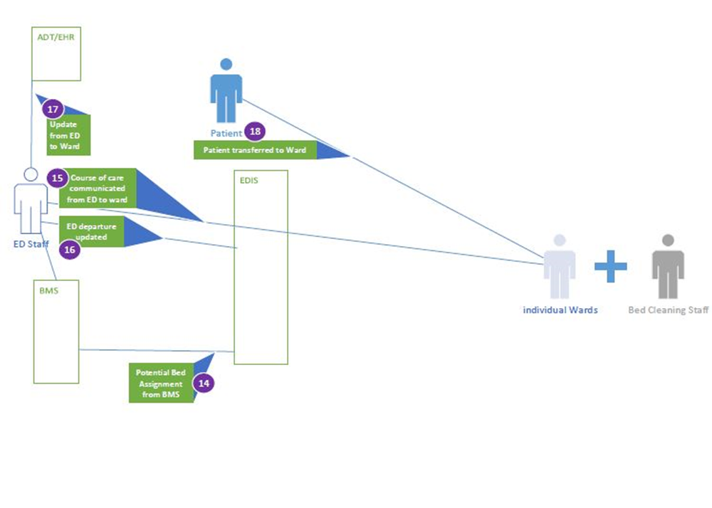
Candidate Bed to Arrival as Inpatient
Story Board 1

Slide 11
Use Case
Story Board 2
Dr. Data leads her hospital's patient flow task force. She wishes to develop a real-time, dynamic dashboard report that shows current trends in average and median ED length of stay as well as other component intervals: door-to-triage; door-to-ED bed; door-to-doctor; doctor-to-disposition decision (i.e. door-to-admit); disposition decision-to-departure. This dashboard would serve to detect and locate bottlenecks. Dr. Data and her taskforce wish to drive new administrative workflows – including event timestamp improvement efforts - in response to different types of apparent bottlenecks.

Slide 12


Standards
HL7 v2.6 ADT, Patient Administration
IHE Patient Administration Management Profile
HL7 EDIS Functional Profile – Registration Release 1 (v1.4)
Project of HL7 ED Special Interest Group and based on HL7 EHR Functional Model
Divided into three sections; ED bed management solutions should conform to functions defined in these three areas:
Direct Care (DC) – for example: Manage Pre-arrival Data (DC.1.2.1)
Supportive Functions (S) – for example: Provider Information (S.1.3)
Information Infrastructure (IN) – for example: Interchange Standards (IN.5.1)
For STAPHYLOCOCCUS AUREUS METHICILLIN RESISTANT (MRSA) the following SNOMED codes are available:
SNOMED CODE: 523700
SNOMED CT ID: 115329001
Notes:
Not wanting to “reinvent the wheel,” our group looked within existing standards for the solutions to our interoperability challenges and found that HL7 v2.6 standards covered most of what we wanted to accomplish. Specifically the Patient Administration chapter of the HL7v2 specification (Chapter 3) along with the IHE Patient Administration Profile fit our needs.
In addition we found an HL7 EDIS functional profile (Registration Release 1, version 1.4) that covers interactions between ED information systems. This profile, which provides a description of how ED information systems should behave, is divided into three sections: direct care, supportive functions, and information infrastructure. ED bed management solutions should conform to specific functions within these three sections:
Direct Care:
ED Merge Registration (DC.1.1.2.3)
Manage Pre-arrival Data (DC.1.2.1)
Manage Assessments (DC.1.5)
Manage Transfers of Care Between ED Providers (DC.1.8.5.3)
Manage ED Disposition (DC.1.10)
Manage ED Discharge (DC.1.10.1)
Manage ED to Hospital Admissions (DC.1.10.1.3)
Support for Clinical Provider Communication (DC.3.2.1.1)
Supportive Functions:
Registry Notification (S.1.1)
Provider Information (S.1.3)
Provider’s Location Within Facility (S.1.3.2)
Patient Directory (S.1.4)
Patient’s Location Within Facility (S.1.4.2)
Patient’s Location Within Emergency Department (S.1.4.2.1)
Department Modeling and Room Modeling (S.1.4.2.2)
Patient Bed Assignment (S.1.4.4)
Outcome Measures and Analysis (S.2.1.1)
ED Benchmarking Reports (S.2.2.2.1)
Ad hoc Query and Report Generation (S.2.2.3)
Other Encounter and Episode of Care Support (S.3.1.5)
Information Infrastructure:
Synchronization (IN.2.3)
Interchange Standards (IN.5.1).
In addition, SNOMED codes are available for use when identifying patients with bed isolation needs based on their MRSA status.

Slide 13
Existing HL7 Transactions
The proposed profile makes use of the following existing HL7 transactions:
Storyboard 1:
ADT^A04^ADT_A01 - Register a Patient
ADT^A14^ADT_A05 - Pending Admit
ADT^A20^ADT_A20 - Bed Status Update
ADT^A15_ADT_A15 - Pending Transfer
ADT^A01_ADT_A01 - Admit/Visit Notification
ADT^A09_ADT_A09 - Patient Departing - Tracking
ADT^A10_ADT_A09 - Patient Arriving – Tracking
Storyboard 2:
ORU^R30^ORU_R30 - Unsolicited Point-Of-Care Observation without Existing Order
ADT^A02^ADT_A02 – Transfer a Patient
ADT^A54^ADT_A54 - Change Attending Doctor
Notes:
All messages are acknowledged by HL7 v2.6 ACK messages and a duplicate copy of each message is sent to the listener actor.

Slide 14
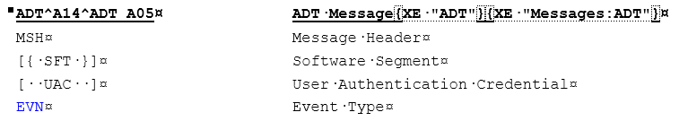
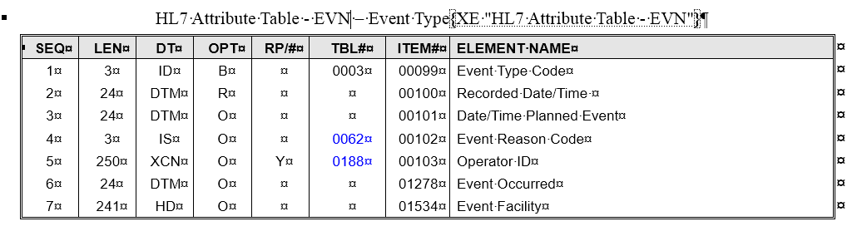
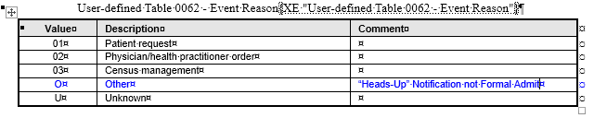
New HL7 Transaction
ADT^A14^ADT_A05 - Pending Admit - “Heads-up”
Notes:
The proposed profile also includes a new transaction:
ADT^A14^ADT_A05 - Pending Admit - “Heads-up” Notification This transaction uses the optional Event Reason Code field in the EVN message segment (updates user-defined table 0062) to indicate that the event type is a “heads-up” notification rather than a formal admit.

Slide 15
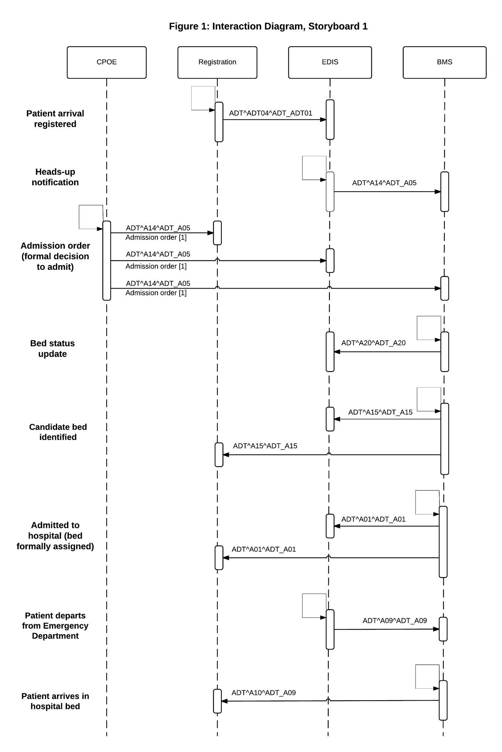
Storyboard 1 Interaction Diagram
Notes:
Our proposal includes two draft interaction diagrams- one for each storyboard- that suggest which HL7 v2.6 messages could offer standard transactions to allow our actors to interoperate.
The figure on this slide displays the interactions proposed for storyboard 1:
At the top of the diagram are the four main actors- CPOE, Registration, EDIS and the BMS.
Along the leftmost column are the workflow events that trigger messages
The body of the diagram shows the actors as initiators and recipients of these messages

Slide 16
Storyboard 1 Interaction Diagram
Arrival to Admission
Admission to Candidate Bed
Candidate Bed to Arrival as Inpatient
Notes:
Here we’ve highlighted how these interactions relate to different phases or aspects of bed management required for a standardized view of storyboard 1 in which:
A patient arrives in the ED, is evaluated, and on the basis of this evaluation, a decision is made to admit the patient to the hospital
Having decided to admit, a hospital bed is formally identified and assigned
With the bed identified, the patient is transferred to this new bed

Slide 17
Storyboard 1 Interaction Diagram
Notes:
For the sake of simplicity, several message sets are not represented in this base diagram. Specifically…

Slide 18

Storyboard 1 Interaction Diagram
Notes:
Cancellation messages would be necessary. Most, if not all of these have also been specified in HL7 v2.6

Slide 19

Storyboard 1 Interaction Diagram
Notes:
All messages would also trigger acknowledgment, or ACK messages

Slide 20
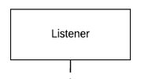
Storyboard 1 Interaction Diagram
Notes:
And, linking Storyboard 1 to Storyboard 2, a Listener actor would be receiving duplicate messages in the background

Slide 21
Storyboard 1 Interaction Diagram
Notes:
And, linking Storyboard 1 to Storyboard 2, a Listener actor would be receiving duplicate messages in the background

Slide 22
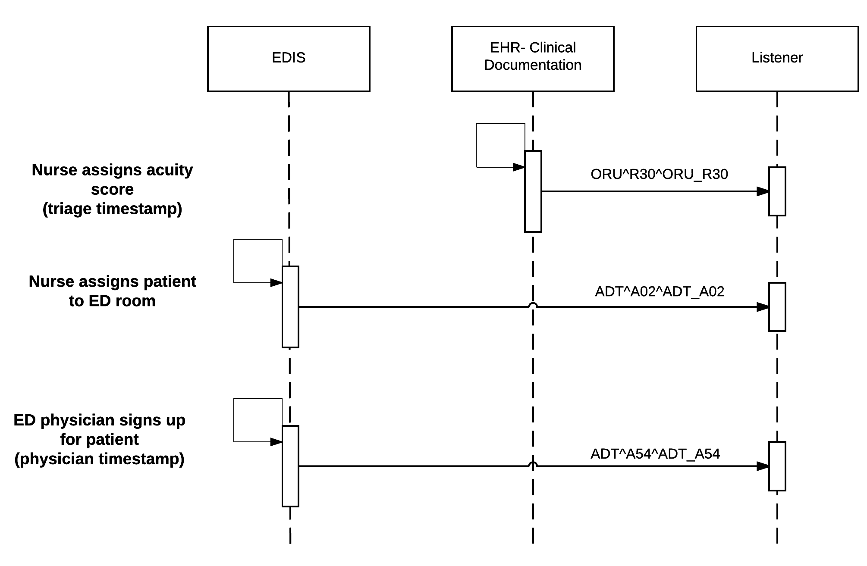
Storyboard 2 Interaction Diagram
Notes:
Storyboard 2 requires additional timestamps to mark different patient flow milestones, namely:
the time at which an acuity score is assigned in triage
the time at which the patient is roomed in the ED (represented as the time the nurse assigns the patient to an ED room)
The time at which a physician declares the beginning of his or her attending role for the patient encounter
The green and red arrows are meant to represent that the Listener would have also been receiving messages introduced in Storyboard 1

Slide 23
Storyboard 2 Interaction Diagram
Notes:
And, as with Storyboard 1, messages that cancel or modify erroneous or altered event conditions would be needed.

Slide 24
Storyboard 2 Workflow Measures
Arrival to Admission
Admission to Candidate Bed
Candidate Bed to Arrival as Inpatient
Notes:
Returning to the phases of care that Kevin outlined (indicated along the bottom of this slide) the messages that support Storyboard 2 demarcate the component measures that Dr. Data needs.

Slide 25
Storyboard 1+2 transactions
Storyboard 2 transactions
Arrival to Admission
Admission to Candidate Bed
Candidate Bed to Arrival as Inpatient
Notes:
The messages you are about to see will be color coded to show their relationship to the Storyboards. Messages that support both Storyboard 1 and 2 will be purple and those that pertain to Storyboard 2 only will be green.

Slide 26
ADT^A02^ADT_A02
ORU^R30^ORU_R30
ADT^A20^ADT_ADT20
ADT^A15^ADT_ADT15
ADT^A14^ADT_A05 (admission)
ADT^A01^ADT_ADT01
ADT^ADT04^ADT_ADT01
ADT^A14^ADT_A05
(heads up)
ADT^A09^ADT_A09
ADT^A54^ADT_A54
Arrival to Admission
Admission to Candidate Bed
Candidate Bed to Arrival as Inpatient

Slide 27
ED Time Intervals
Door to triage = ADT^A54^ADT_A54 – ADT^ADT04^ADT_ADT01
Door to ED bed = ADT^A02^ADT_A02 – ADT^ADT04^ADT_ADT01
Door to Doc = ORU^R30^ORU_R30 – ADT^ADT04^ADT_ADT01
Bed to Doc = ORU^R30^ORU_R30 – ADT^A02^ADT_A02
Doc to Disposition = ADT^A14^ADT_A05(a) – ORU^R30^ORU_R30
Decision to Depart = ADT^A09^ADT_A09(a) – ADT^A14^ADT_A05(a)
ED Length of Stay = ADT^A09^ADT_A09(a) – ADT^ADT04^ADT_ADT01
ADT^A02^ADT_A02
ORU^R30^ORU_R30
ADT^A20^ADT_ADT20
ADT^A15^ADT_ADT15
ADT^A14^ADT_A05 (admission)
ADT^A01^ADT_ADT01
ADT^ADT04^ADT_ADT01
ADT^A14^ADT_A05
(heads up)
ADT^A09^ADT_A09
ADT^A54^ADT_A54
Arrival to Admission
Admission to Candidate Bed
Candidate Bed to Arrival as Inpatient
Notes:
Patient flow intervals can be calculated from the timestamps associated with message transmission:
Door to triage = ADT^A54^ADT_A54 – ADT^ADT04^ADT_ADT01
Door to ED bed = ADT^A02^ADT_A02 – ADT^ADT04^ADT_ADT01
Door to Doc = ORU^R30^ORU_R30 – ADT^ADT04^ADT_ADT01
Bed to Doc = ORU^R30^ORU_R30 – ADT^A02^ADT_A02
Doc to Dispo = ADT^A14^ADT_A05(adm) – ORU^R30^ORU_R30
Decision to Depart = ADT^A09^ADT_A09(1st) – ADT^A14^ADT_A05(adm)
ED LOS = ADT^A09^ADT_A09(1st) – ADT^ADT04^ADT_ADT01

Slide 28
ADT^A02^ADT_A02
ORU^R30^ORU_R30
ADT^A20^ADT_ADT20
ADT^A15^ADT_ADT15
ADT^A14^ADT_A05 (admission)
ADT^A01^ADT_ADT01
ADT^ADT04^ADT_ADT01
ADT^A14^ADT_A05
(heads up)
ADT^A09^ADT_A09
ADT^A54^ADT_A54
Arrival to Admission
Admission to Candidate Bed
Candidate Bed to Arrival as Inpatient
Notes:
In addition to traditional retrospective patient flow modeling for the purpose of improving process improvement, these timestamps could offer additional benefits. Examples:
Data quality and system implementation monitoring:
Are the time intervals of appropriate magnitude? I.e., is Door to bed always greater than Door to triage? If not, can the listener give real-time feedback re: missed acuity scores or delayed timestamps?
Is ADT^A14^ADT_A05 (heads up) being used?
Is its lack of use associated with longer Decision-to-Departure times, and if so, is this only true for certain units or patient cohorts?
Decision support:
Can census rules be created such that the transmission of ADT^A14^ADT_A05 (heads up) messages trigger earlier resource mobilization in certain high census or acuity contexts?

Slide 29
Prediction Modeling
Messaging (and collection of messages with a listener) allows real-time use of data by external functions
Interest in predicting admissions from data at time of triage or as care proceeds in ED
Might allow flexibility in management of inpatient beds, a scarce resource in hospitals, and nursing staffing (a potentially flexible resource)
Notes:
There’s been some interest from the field of being able to predict the number of admissions coming from the emergency department as early as possible. The use of standard messaging and the presence of a listener actor in the messaging bus allows data from the ED to be used by a prediction model to estimate future admissions. It is possible that health systems will be able to use this data to better manage the scare resource of beds, to adjust staffing levels for upcoming shifts, and at minimum, to give advanced notice as the hospital nears full capacity.

Slide 30
Discussion
Goal - create a profile that enables interoperable systems
Workflow considerations
HL7 chosen standard
ED vs Routine Care
Notes:
In summary, we have developed initial work at a profile focusing on the task of bed management, focusing specifically on the handling of bed request from emergency department admissions. Clearly, this work could be integrated into a wider bed-management profile which could encompass direct admissions, post-surgical admissions, transfers from other hospitals, and inter-ward transfers within a hospital. We chose HL7 V2 messaging as it, at present, seemed to be able to encompass the vast majority of the concepts and data items that are necessary for communicating these activities.

Slide 31
References
Pines JM, Batt RJ, Hilton JA, Terwiesch C. The Financial Consequences of Lost Demand and Reducing Boarding in Hospital Emergency Departments. Ann Emerg Med. 2011 Oct;58(4):331–40.
Singer AJ, Thode HC, Jr., Viccellio P, Pines JM. The association between length of emergency department boarding and mortality. Acad Emerg Med. 2011;18(12):1324-9.

